Slide 1
Educational Technology for TRU Students
Tools and Supports and Ideas
Matthew Stranach, TRU Open Learning

Slide 2
Getting Started
Moodle and beyond
Learning Without Walls
WordPress / TRUBox
BigBlueButton
Kaltura Media
Mattermost messaging
Open ETC and Sandstorm apps
Office 365--- and other IT Services offerings
Texthelp Read&Write
LinkedIn Learning
Final thoughts

Slide 3
Image via Kids Britannica: https://kids.britannica.com/students/assembly/view/157697
Via TRU Marketing and Communications

Slide 4
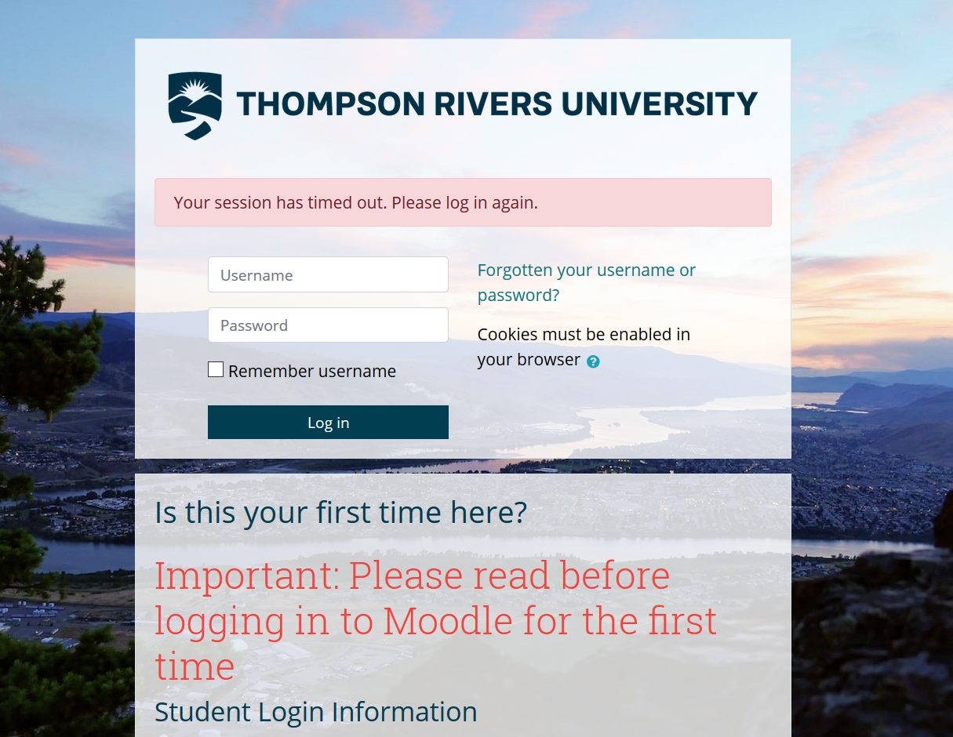

Slide 6
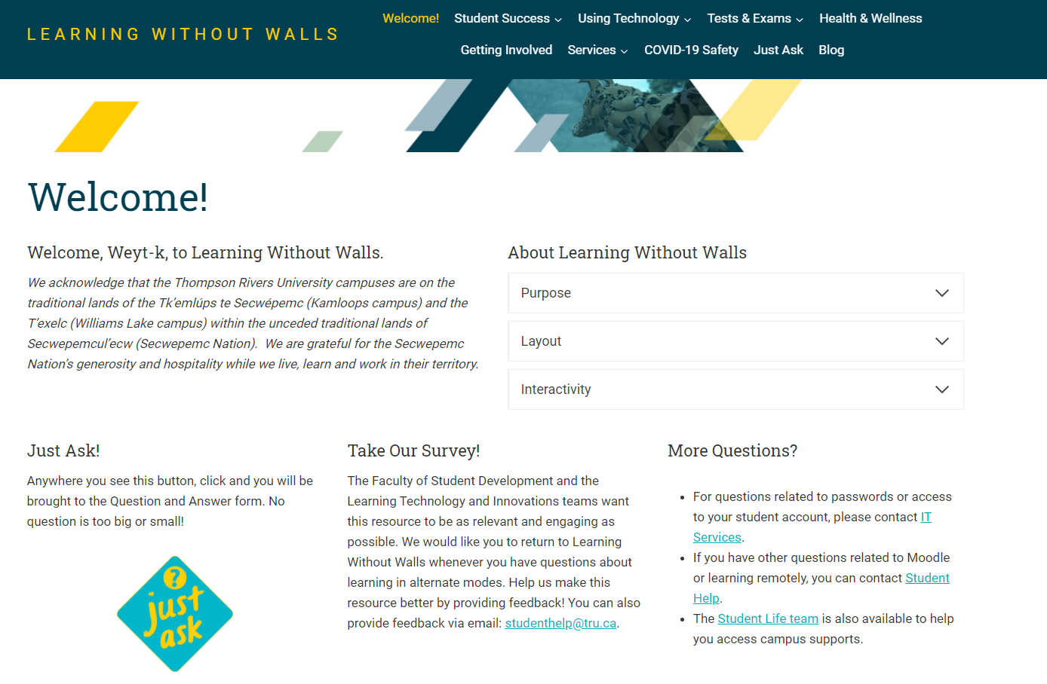

Slide 8
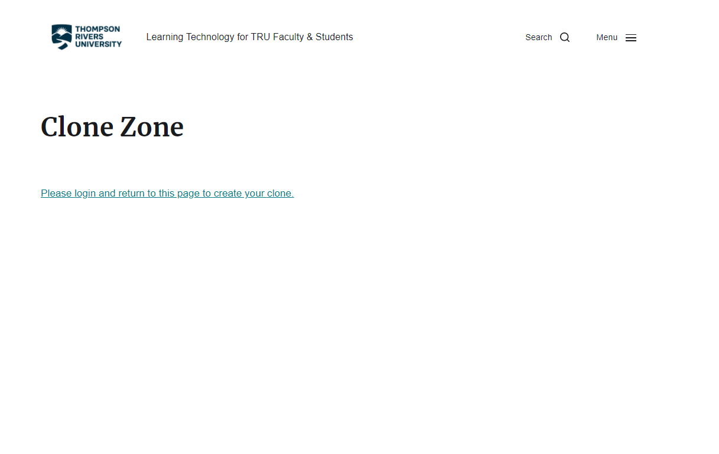

Slide 9
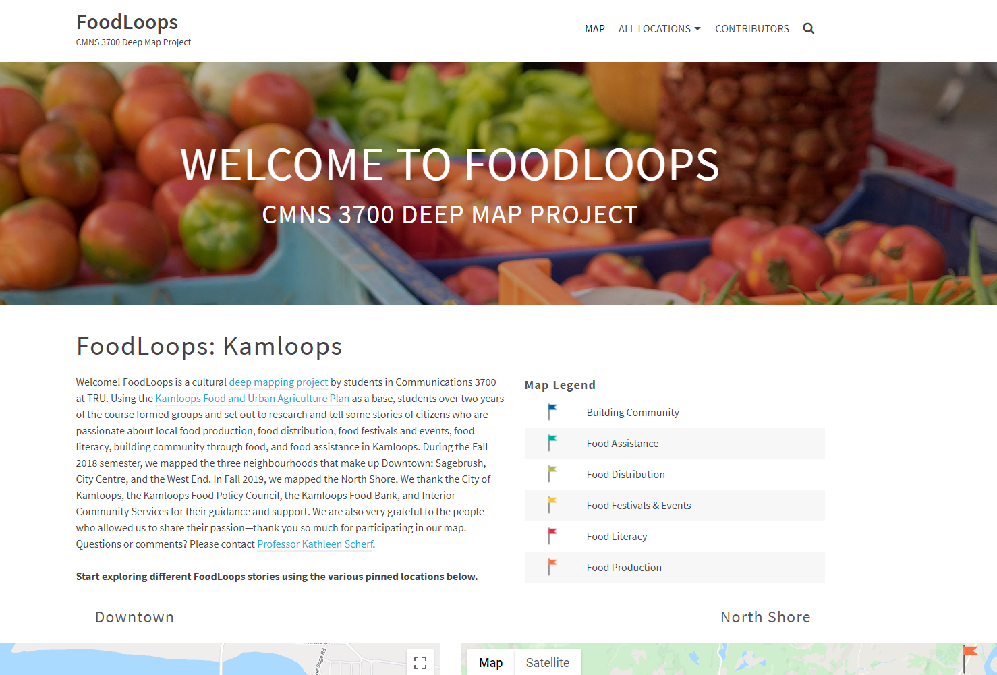

Slide 10
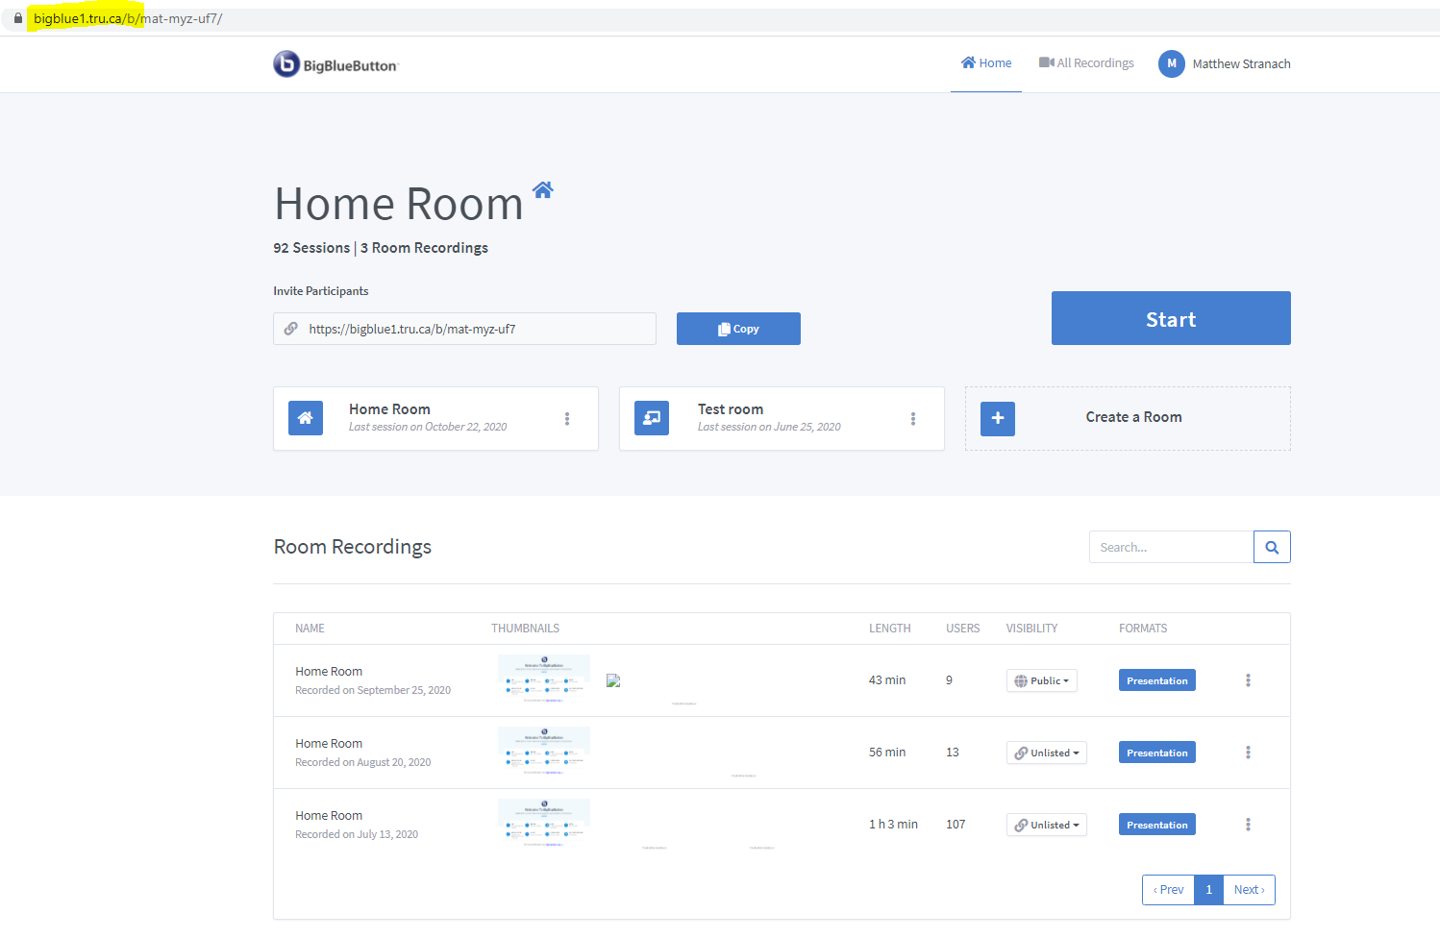

Slide 11
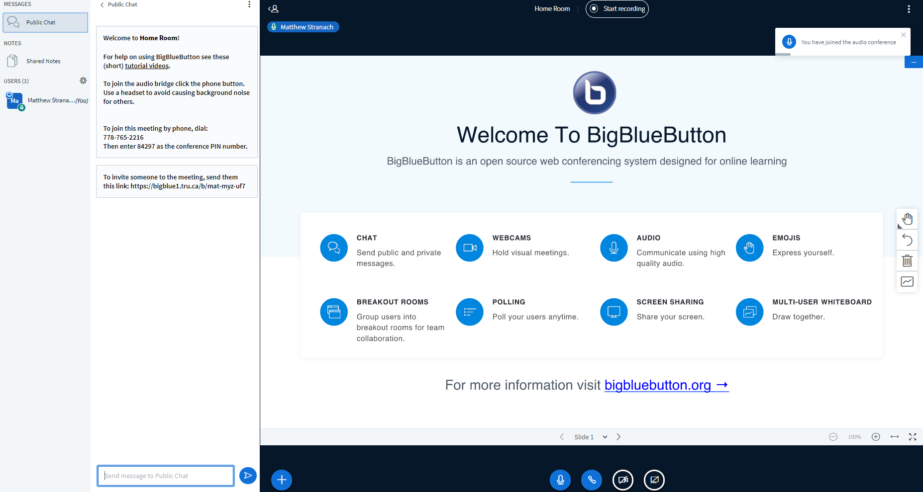

Slide 13
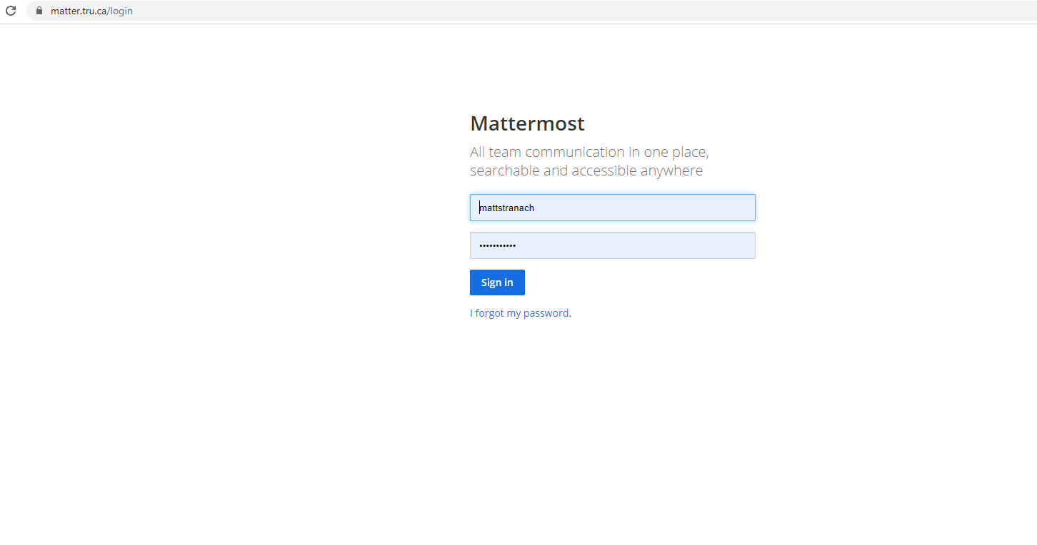

Slide 14
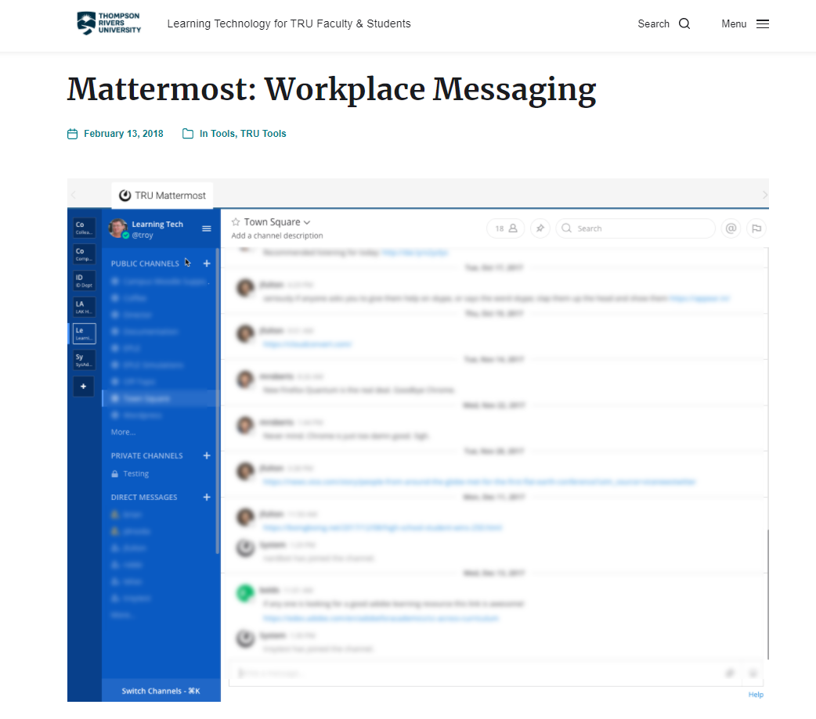

Slide 17
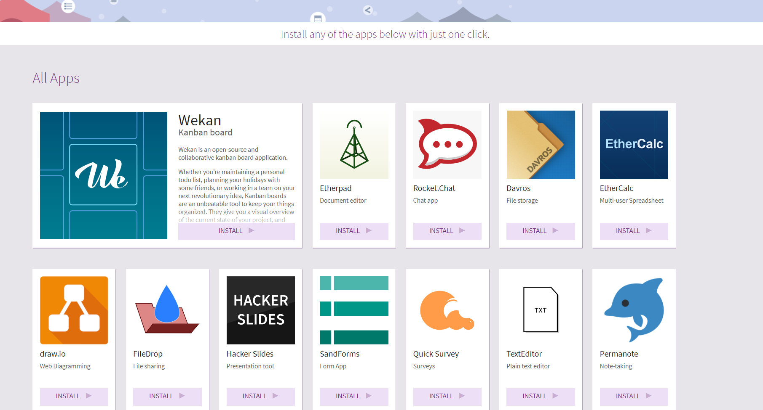

Slide 18
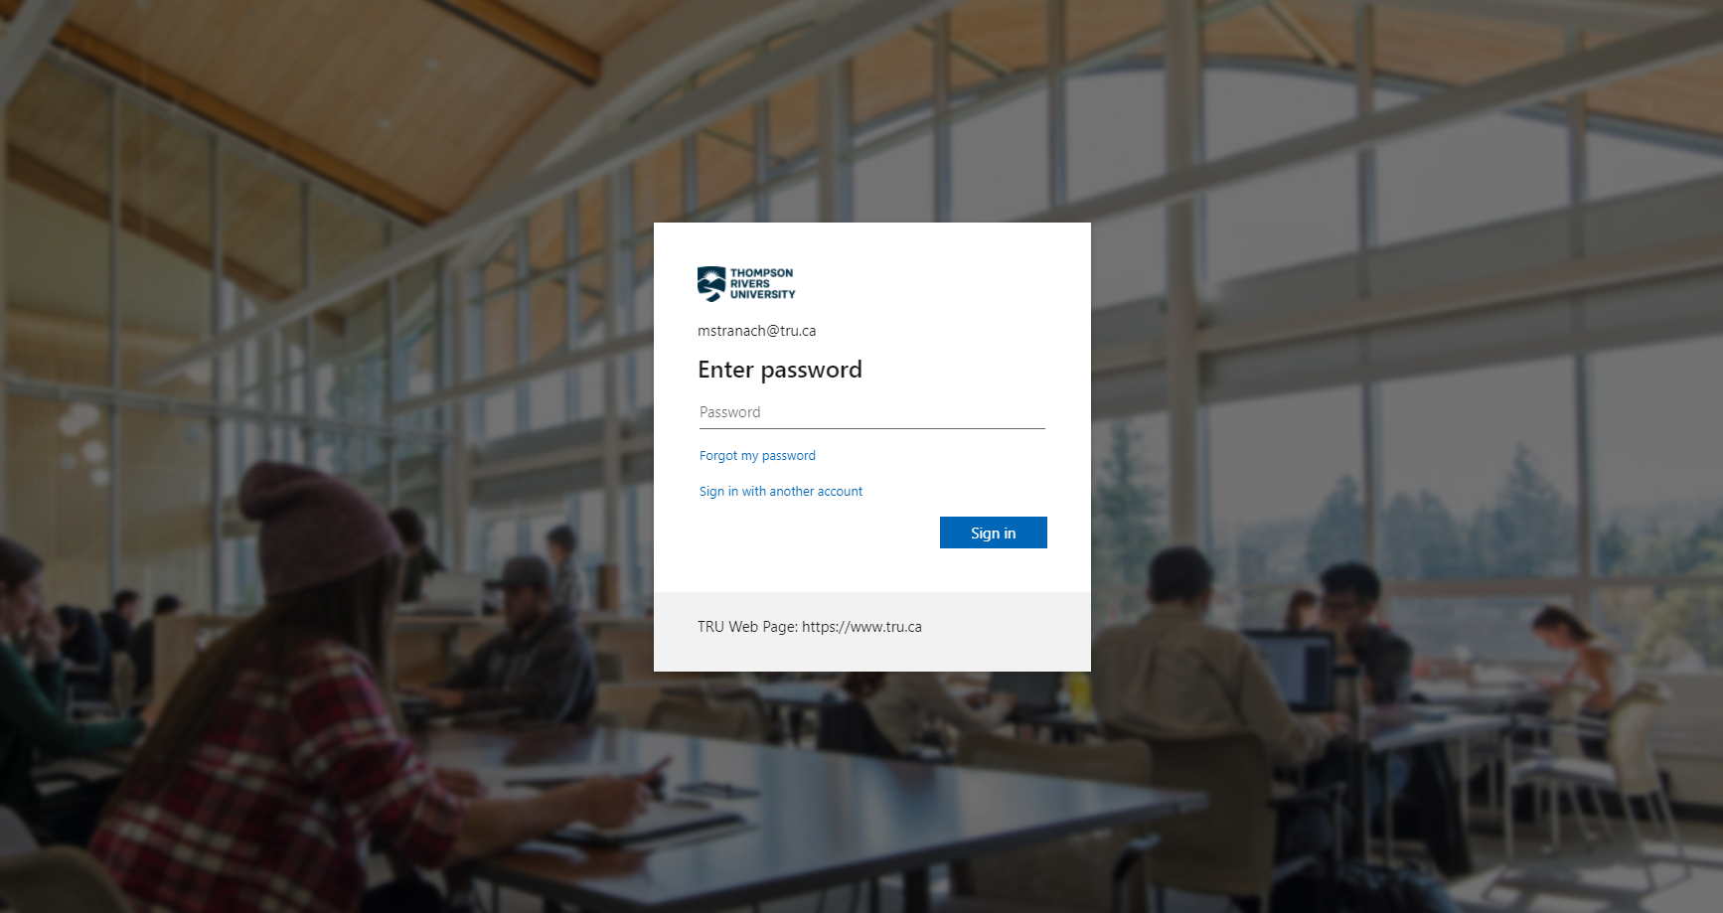

Slide 20
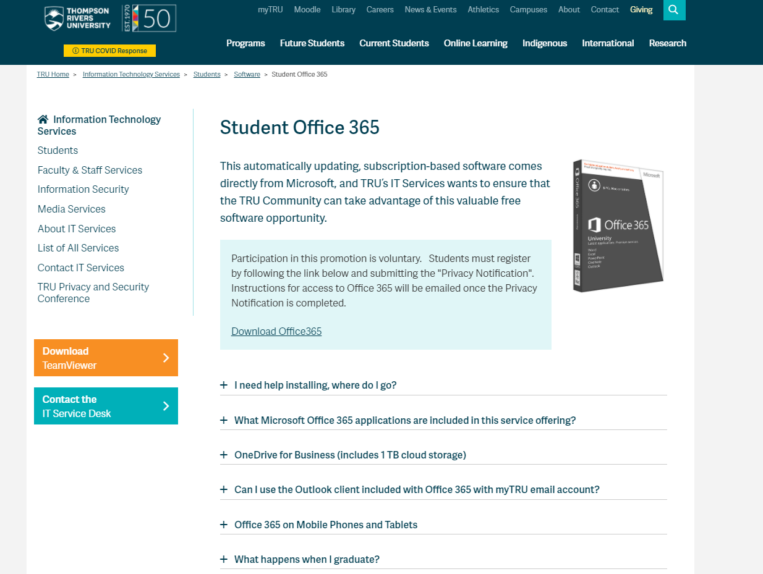

Slide 21
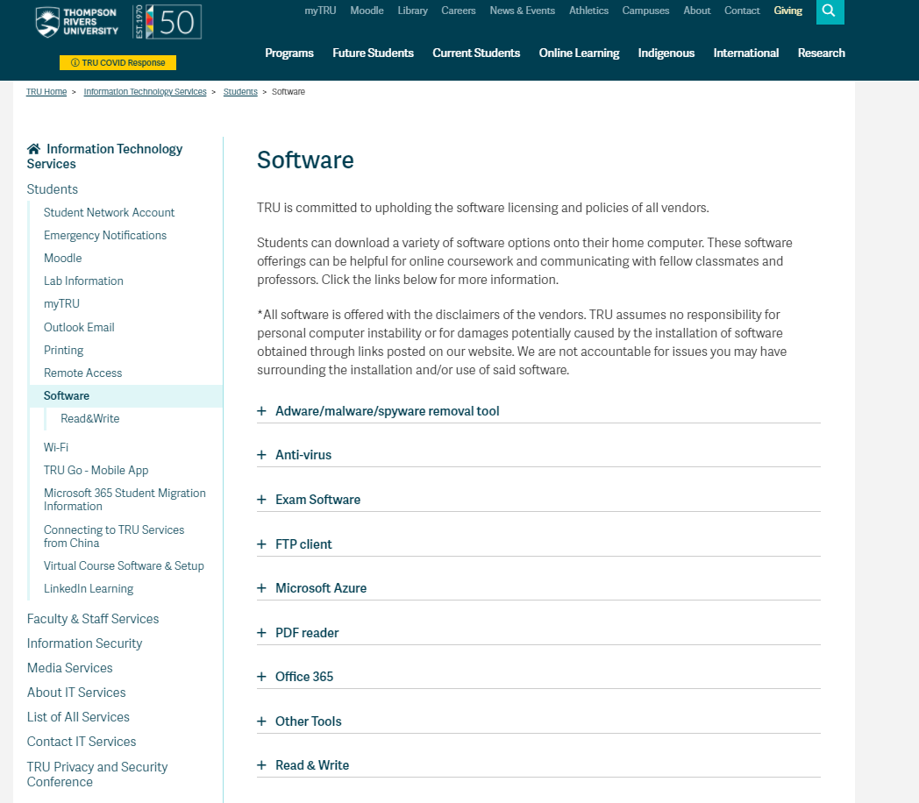

Slide 23
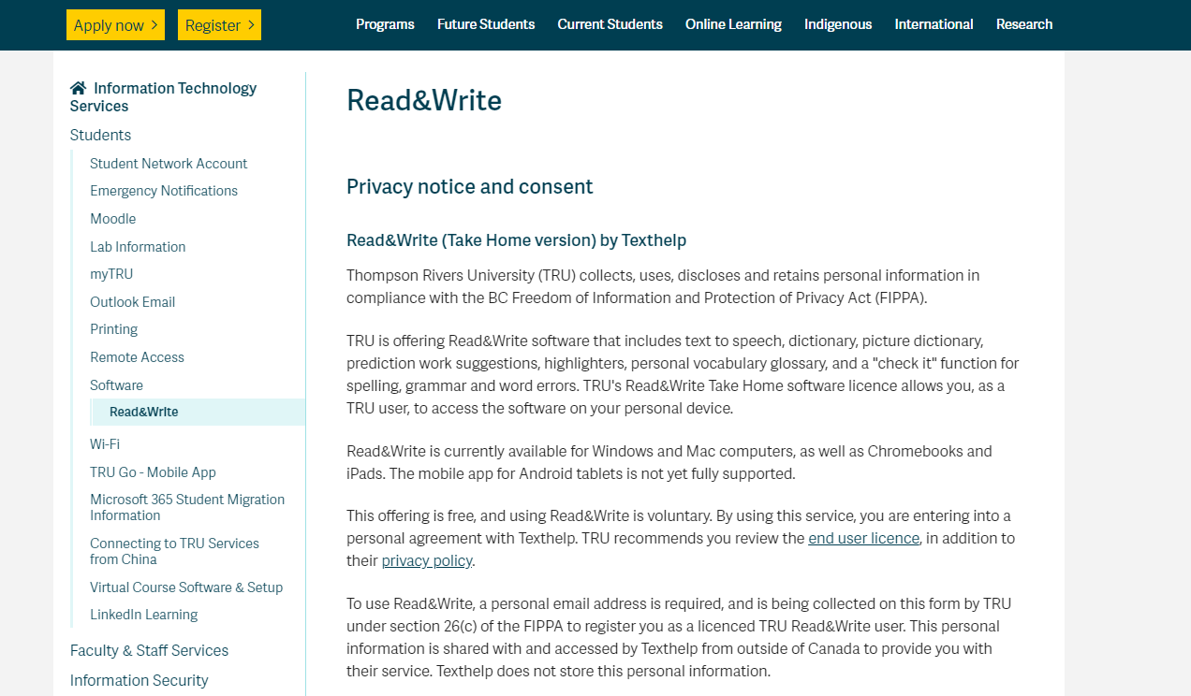

Slide 24
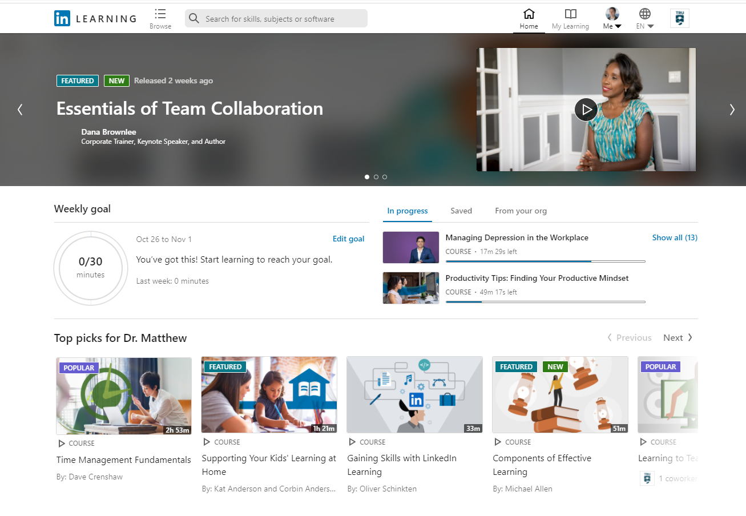

Slide 25
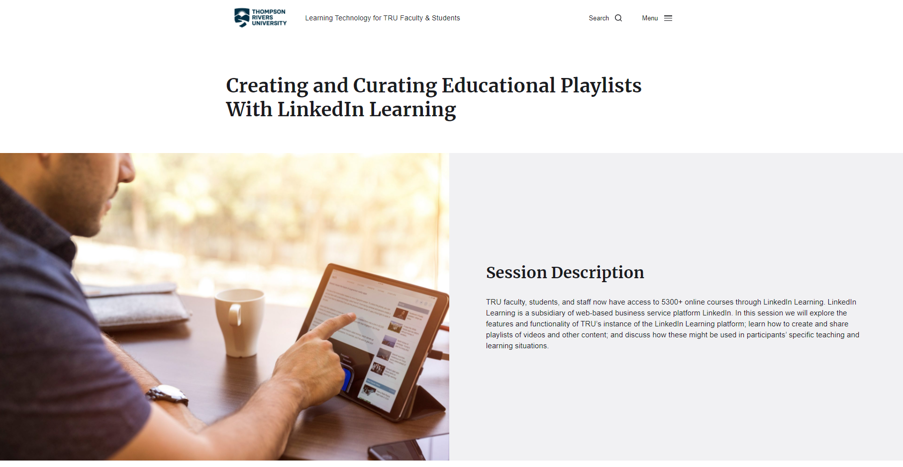

Slide 26
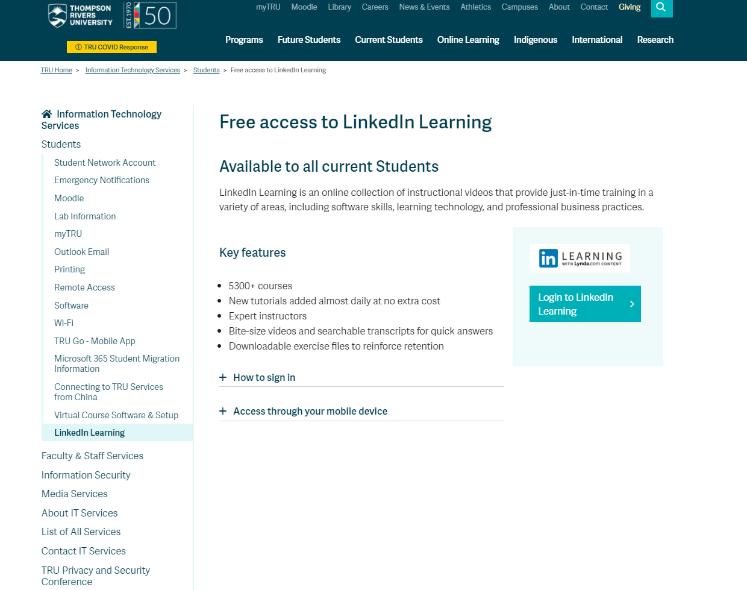

Slide 27
Thank you!
Contacts:
Moodlesupport@tru.ca
itservicedesk@tru.ca
studenthelp@tru.ca
mstranach@tru.ca

